Slide 1
Software Engineering I
Lecture 27
CS61B, Fall 2023 @ UC Berkeley

Slide 2
Background
Background
Complexity
Strategic vs Tactical Programming
Retool
Commit History Traversal
Summary
Lecture 27, CS61B, Fall 2023

Slide 3

Background
I’m the guest lecturer for today, Aniruth Narayanan.
Senior, majoring in EECS and Business
Teaching Assistant for 61B
First taught 61B in Summer 2021
From Florida
Took a gap year to work in industry
The subject of this lecture!
Later, I’ll talk about some of the problems I’ve worked on
Q & A will be at the very end.

Slide 4
Disclaimers
Some important disclaimers:
Nothing I say should be interpreted as anyone’s opinion but my own.
Nothing contained in these slides is confidential or proprietary information of any company.
The sections on complexity and strategic/tactical programming are inspired by Josh Hug’s slides (think of these as less detailed versions).

Slide 5
Scale
In 61A, you were focused on the correctness of a program.
In 61B, you are focused on larger scale projects, but still have to abide by many of our requirements and specifications (e.g. functions, runtime, etc.).
Working on small projects isn’t the same as working on large scale, design-oriented programs where the task is defined by you.
The best way to learn these differences is through experience; this lecture will have some examples and some light theory as a sampling.
Project 3 allows you to embrace the challenge of large scale yourself.

Slide 6
Complexity
Background
Complexity
Strategic vs Tactical Programming
Retool
Commit History Traversal
Summary
Lecture 27, CS61B, Fall 2023

Slide 7
Restrictions of Engineering
In other disciplines, we’re limited by imperfect materials.
Objects can’t be infinitely dense, or infinitely light.
Many fields are constrained:
Chemical engineers have to worry about temperature.
Material scientists have to worry about how brittle a material is.
Civil engineers have to worry about the strength of concrete.
In computer science, we’ve solved most of the underlying material constraints decades ago.
The sum power of Apollo missions is less than the computing power of your phone.

Slide 8

The Power of Software
Early computers were used for limited tasks.
This is a picture of ENIAC, the first general-purpose programmable computer that was 1,000 times faster than anything else at the time.
Notes:
Image from https://en.wikipedia.org/wiki/History_of_computing_hardware

Slide 9
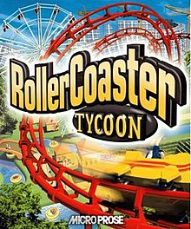
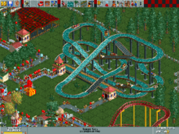
The Power of Software
Rollercoaster Tycoon was an early game where players would design amusement parks.
99% of the code was written in Assembly, with 1% written in C.
This is very hard for programmers to reason about.
The game was designed to run on Intel Pentium CPUs, which were 66 MHz (66 million operations per second).
The Intel i9 14th Gen of today can run at up to 6GHz (6 billion operations per second). 100x more
Notes:
Images from https://en.wikipedia.org/wiki/RollerCoaster_Tycoon_(video_game)

Slide 10


The Power of Software
Most video games today require at least 3.5 GHz and 8 GB of RAM.
In 1996, the average computer had only 8 MB or 16 MB of RAM.
The average software product doesn’t require the computing power we have available today.
The limitation comes from the creative ways we plan and design what we’re building.
An individual programmer is no longer able to effectively manage the entire software system for a large project.
Any one programmer should only need to understand a fraction of the codebase.
Notes:
Requirements from https://www.minecraft.net/en-us/store/minecraft-java-bedrock-edition-pc

Slide 11
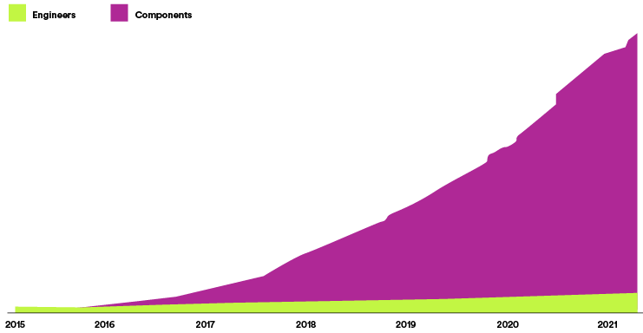
Empirical Proof
Here’s an example from Spotify’s Engineering Blog of their approach to software. They have >1 billion lines of code, 60 million used in production.
They must carefully target and orchestrate changes using internal mechanisms and thorough test automation.
Notes:
Image is also from the engineering blog (link in slide)

Slide 12
A Definition of Complexity
“Anything related to the structure of a software system that makes it hard to understand and modify it” - John Ousterhout, “A Philosophy of Software Design”
As programs become more feature-rich, their complexity increases. Our goal is to keep software simple.
Why? Complex systems require a lot of effort to make small improvements.
It takes longer to understand how code works
It is more difficult to fix bugs independently and with confidence
It it harder to find what needs to change to modify functionality
Unknown unknowns: it’s not clear what you need to know to make modifications
Common in large codebases

Slide 13
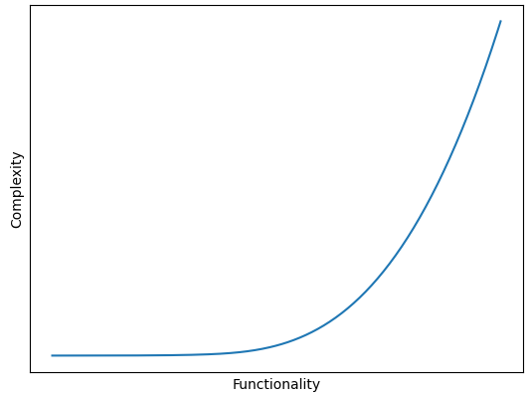
The Runtime of Complexity
Complexity scales exponentially with respect to functionality.
Each new piece of functionality has to interact with all the existing functionality in various ways, for all possible combinations.
Notes:
Code to generate the plot:
import matplotlib.pyplot as plt
import numpy as np
from scipy.interpolate import make_interp_spline, BSpline
x = range(10)
xnew = np.linspace(0, 20, 300)
y = [(2**i) for i in x]
spl = make_interp_spline(x, y, k=3)
smooth = spl(xnew)
plt.plot(xnew, smooth)
plt.xlabel("Functionality")
plt.ylabel("Complexity")
plt.xticks([])
plt.yticks([])
plt.show()

Slide 14
Managing Complexity
There are two kinds of complexity:
Unavoidable (Essential) Complexity
Inherent complexity caused by the underlying functionality
Avoidable Complexity
Complexity that we can address with our choices
In response to avoidable complexity, we can:
Make code simpler and more obvious
Using sentinel nodes in Project 1
Modules
Abstraction: the ability to use a piece without understanding how it works based on some specification
Interfaces are an example - HashMap, BSTMap both are Maps

Slide 15
Strategic vs Tactical Programming
Background
Complexity
Strategic vs Tactical Programming
Retool
Commit History Traversal
Summary
Lecture 27, CS61B, Fall 2023

Slide 16
Tactical Programming
The focus is on getting something working quickly; workarounds are leveraged.
Ex: Code that contains many if statements to handle many separate cases that is hard to explain
Prototypes, proof-of-concepts leverage tactical programming. The goal is to show that something could theoretically work.
However:
There’s no time spent on overall design
Things are complicated with workarounds to get things working
Refactoring takes time and potentially means restarting
Consider Project 2 runtime requirements and planning the constructor
Proof of concepts are deployed in the real world due to lack of time

Slide 17
Strategic Programming
A different form of programming that emphasizes long term strategy over quick fixes. The objective is to write code that works elegantly - at the cost of planning time.
Code should be:
Maintainable
Simple
Future-proof
61B projects have deadlines; afterwards, you can throw it away
If the strategy is insufficient, go back to the drawing board before continuing work.
Helper method strategy is key to leverage throughout projects, especially when we have written comprehensive tests to ensure that these methods are correct.

Slide 18
Retool
Background
Complexity
Strategic vs Tactical Programming
Retool
Commit History Traversal
Summary
Lecture 27, CS61B, Fall 2023

Slide 19
Retool
Retool is a platform to help build internal tools much faster.
Instead of building a frontend and a backend from scratch, you can write queries, linked to drag and drop components
Much of this power comes from being able to connect to nearly any API or database
API: An interface for working with data; we don’t care about how it works underneath the hood, just that we can use the specifications.
We can connect different sources of data and code together to make building easier.
I worked as a software engineer intern on the Connect team in Fall 2022.
One of the projects I worked on was incorporating missing fields into the resource creation system.

Slide 20
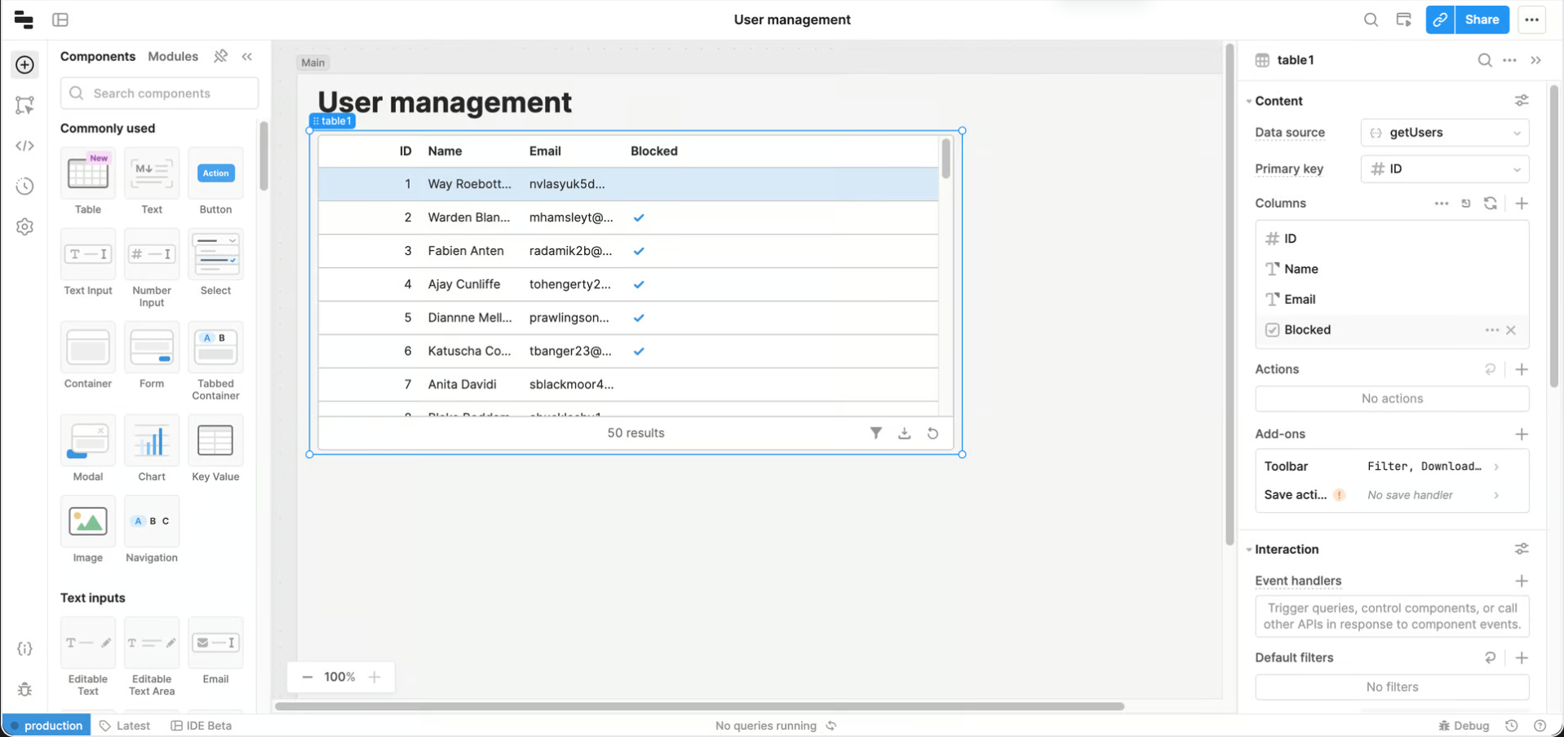
Building a Retool App
Image from Retool’s Documentation

Slide 21
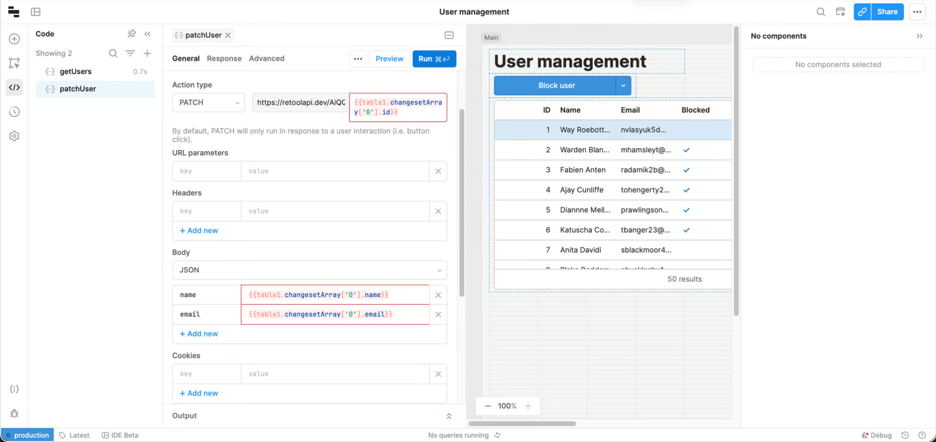
Adding a Query
Image from Retool’s Documentation

Slide 22
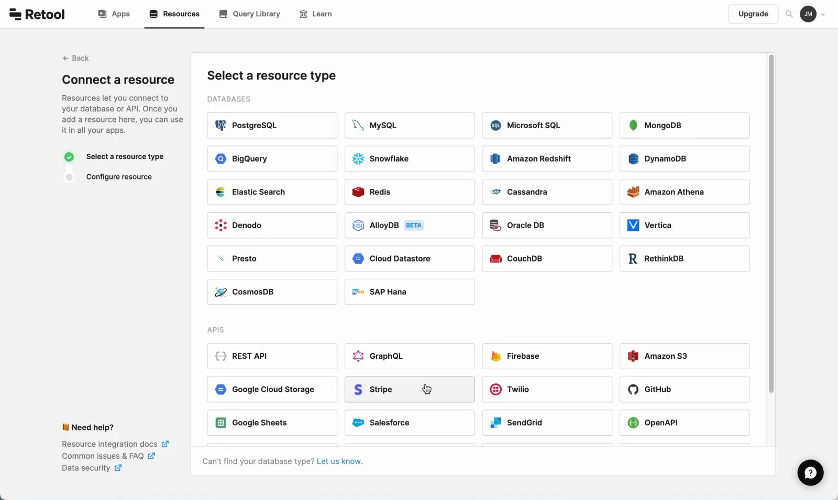
Picking a Resource
Image from Retool’s Resources Documentation

Slide 23
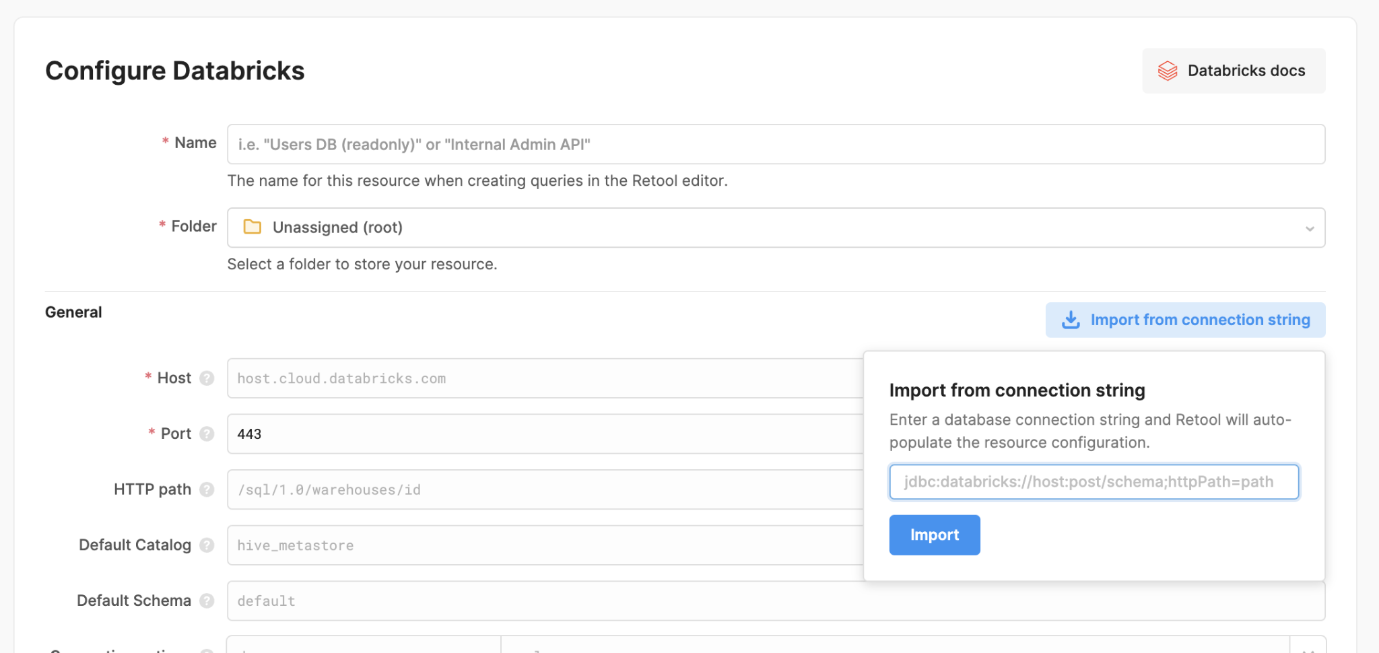
Configuring a Resource
Image from Retool’s Resources Documentation

Slide 24
Designing Resource Configurations
Disclaimer: the method to implement resources was decided before I joined, but I needed to both understand and upgrade functionality.
The goal is to design a system for users to specify configuration information that allows Retool to connect to and retrieve information from a resource on the user’s behalf.
The naive implementation is to build a new page for each resource in its entirety.
Problems with this solution:
Making a modification (such as wording) would require updating every page
Breaking changes from updated requirements requires updating every page
What is the List interface changed from size() to .length?
Adding a new resource is complicated (and requires a lot of copy-paste)

Slide 25
Designing Resource Configurations
The ultimate solution was to build a ResourceConfig - a way to describe properties of a resource with a few parameters using common patterns to generate inputs.
This leverages modularity and obviousness when designing a config.
Most databases have similar requirements: a host, a port, a name, and sometimes connection options.
For non-database resources (i.e. Elastic Search), a similar pattern of using inputs can be used with custom elements for properties to accept.
Not all resources were valid.
If a user did not submit the necessary information for a resource, they wouldn’t be allowed to make the resource.
Java prevents you from writing knowingly bad code with compiler errors.
This was specified in a validation function included in the resource config.

Slide 26
Missing Fields
When users put in their credentials, there’s an option to Test Connection with a sample request. If the validation function failed, this was grayed out.
My objective was to add a way to track missing fields and incorporate some validation for fields.
This way, a user can be informed what needs to be changed when making a resource fails.
A strategy question: How can we expand functionality to include this? What do we need to change?

Slide 27
Solution and Refactoring
The solution was to rethink validation as passing the missing fields test.
Parameters would be cycled through, and if one was missing, the accompanying “missing field” is added to the list.
If the list of missing fields is empty, then the resource can be tested/created!
The fields were upgraded to integrate and generalize validation.
For example, every port number for a database should be a number.

Slide 28
Testing
Testing in the real world is very important! There is no autograder to leverage to gain confidence in a solution.
Would the right missing fields be displayed?
For the “patterned” resources, such as a database, I wrote a utility that tested every possible combination of inputs and outputs.
If there were mock resources, this could be expanded into queries.
For the other resources, select test cases were chosen and manually written.
This pattern is powerful - updating the utility updates the tests for all resources.
Resources (and libraries/dependencies) update all the time, sometimes with breaking changes. This is future-proof code.

Slide 29
Commit History Traversal
Background
Complexity
Strategic vs Tactical Programming
Retool
Commit History Traversal
Summary
Lecture 27, CS61B, Fall 2023

Slide 30
The Problem
As a hypothetical: let’s say I want to find which versions of my project contain a certain change. Some of these versions (represented by git commits) are special - they were deployed into the real world.
It’s a common practice in industry - it makes more sense to do predictable rollouts instead of deploying every commit.
Would you want to have 5 or 6 updates to your phone every day?
Apple and Google release new versions of their OS, browsers, apps, etc. in a cycle, with minor changes in between. They don’t release every single time a new commit is pushed internally.
There are many applications of this: rollbacks, adoption rate, metrics comparison, etc.

Slide 31
Some Constraints
For simplicity:
Each change is a git commit - the same git commits generated when you use git commit -m “submitting lab1” and pushed using git push origin main.
There is easy access to all of the git commits that can be loaded on any computer in a reasonable amount of time.
There are a lot of commits - caching the results (i.e. storing which commits are in every single deployment) is infeasible.
Once a change is made, we don’t undo or modify that change (in practice, we can use git blame).
Manually splitting the commits into two sets by hand is slow.

Slide 32
The Git Graph
Consider the following graph of commits, where arrows are drawn to a commit’s parents. Some of these are the deployed commits, marked in green.
Which deployed commits contain the change in commit C?
D
E
G
A
F
B
C
H
Time of Commit

Slide 33
The Git Graph
Consider the following graph of commits, where arrows are drawn to a commit’s parents. Some of these are the deployed commits, marked in green.
Which deployed commits contain the change in commit C?
D
E
G
A
F
B
C
H
Time of Commit

Slide 34
The Git Graph
Consider the following graph of commits, where arrows are drawn to a commit’s parents. Some of these are the deployed commits, marked in green.
Which deployed commits contain the change in commit C?
C, D, and G!
D
E
G
A
F
B
C
H
Time of Commit

Slide 35
An Approach
Consider two approaches:
Work backwards in the reverse direction of the commits storing parents
We don’t have access to this information; git is designed to tell us parents of commits (such as through git log)
This is what we did previously!
Work in the direction of the commits storing parents
We have to grab every single “ending commit” and then work through all the parents until we hit the change we’re checking for in commit C.
If we don’t hit the change, we can only terminate once we work backwards enough to find commits from all parents that have timestamps before commit C.

Slide 36
Approach 2
This approach requires us to work backwards from all commits after the time of the given commit.
It’s also a bit more challenging to implement: we need timestamps and there might be a lot of branches (each with its own ending commit).
D
E
G
A
F
B
C
H
Time of Commit

Slide 37

The Solution
The solution comes in the way that we store data!
We normally think about Git in a commit/parent relationship. For example:
What if the direction of the edges was reversed? That way, a BFS from the commit can be done forward in time to find deployments that contain it.
This could be implemented using an adjacency list as opposed to storing just one (or two) parent(s) since a commit can only have one parent (two if it’s a merge commit), but it could have infinite children.

Slide 38
The Solution, Continued
We can incorporate more time-based optimizations to restrict the search, but here’s the general idea:
Build a git commit graph in reverse order, storing mappings from commits to a list of children
Generate a set of the deployed commits (separate from the graph)
Why might I want to use a set instead of a list?
Runtime! A HashSet gives me amortized constant runtime as opposed to a LinkedList or an ArrayList.
Do a BFS from the input commit and check if commits traversed are in the deployed commits.
We could take multiple input commits here and compute only step 3.
This is much faster! No more manual binary search! Obvious and modular!
This problem itself is a subproblem of a larger project which is simpler to solve.

Slide 39
Summary
Background
Complexity
Strategic vs Tactical Programming
Retool
Commit History Traversal
Summary
Lecture 27, CS61B, Fall 2023

Slide 40
Summary
Good code is more than just working code. Code (and complexity) scales with functionality and poses more challenges to effectively maintain.
Practice good design principles in your classes!
The real world will give you ambiguous problems with loosely defined constraints; it is your duty to make sense of these and then leverage your skills to select the best solutions given constraints while considering tradeoffs.
If this kind of content sounded interesting to you - check out engineering blogs! I also write about similar topics.

